Slide 1
Primary Concepts in Transformational Visioning
NO
PROBLEM
CAN BE SOLVED
OUT OF THE
SAME LEVEL
OF CONCIOUSNESS
THAT CREATED IT!

Slide 3
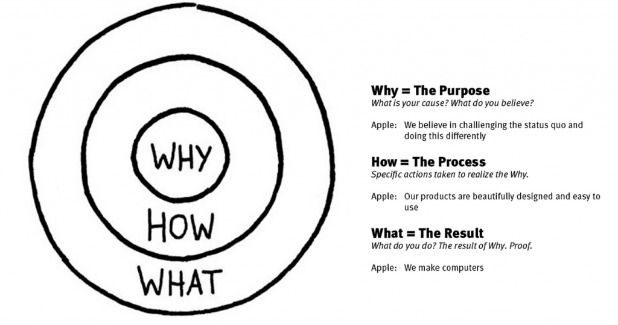

Slide 4
1st CONCEPT
KNOW
YOUR
WHY
Your God given identity and purpose
that evoke life giving passion and excitement
and take you out of your status quo and comfort zone.

Slide 5
MISSIONAL MAINTENANCE

Slide 6
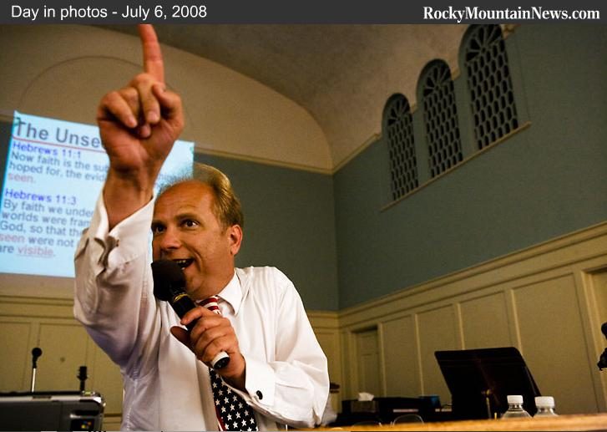
Some churches operate as though…
The Pastor is the performer
The Congregation is the audience
God is the prompter

Slide 7
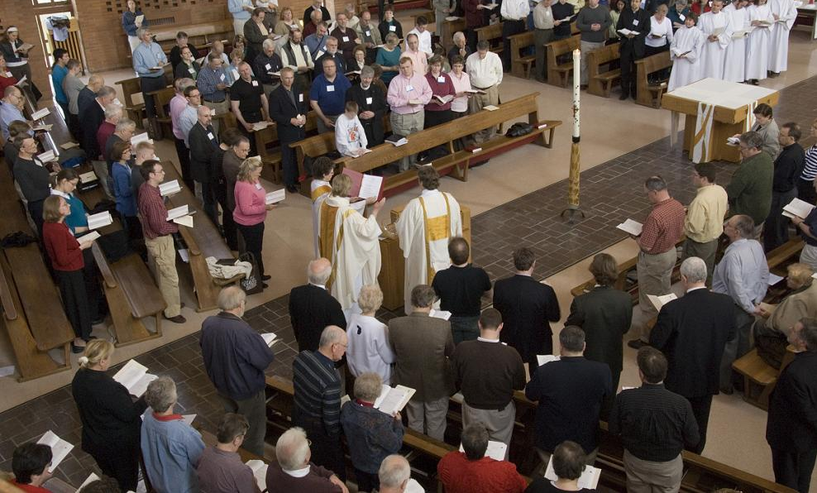
What should it be?
The Congregation is the performer: passionately and enthusiastically living its God given WHY outside its comfort zone.
The Pastor is the prompter/partner
God
is the
audience

Slide 8
2nd CONCEPT
SHIFT
FROM
MAINTENANCE
TO MISSIONAL

Slide 9
CHANGING LANDSCAPE
THE WORLD
IN FRONT OF YOU
IS NOTHING LIKE
THE WORLD
BEHIND YOU
~Tod Bolsinger Canoeing the Mountain

Slide 10
CHANGING LANDSCAPE: Away:
Churches are hypocritical
Churches impose doctrine and morals
Churches are meddling in politics
Churches are vitriolic/toxic on moral issues
Churches are out of touch
Churches are boring

Slide 11
CHANGING LANDSCAPE Towards:
Conversation and dialogue: Informality
Acceptance and belonging
Meaningful generativity (make a difference)
Peace – Poverty -- People -- Planet
Mystical encounter with Holy; particularly in and through the sacred natural world

Slide 12
GENERATIONAL COHORT % OF “UNAFFILIATED”
Builders/Silents (before 1946) 9%
Baby Boomers (1946 – 1964) 15%
Gen X (1965 – 1980) 21%
Millennials (after 1980) 33%
Gen Y (after 2000) 50 – 75%

Slide 13
3rd CONCEPT
It’s a
Different World
People are leaving institutional religion, and God is active in the world.

Slide 14
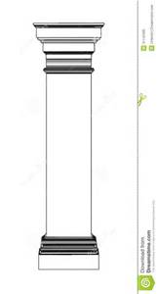
DISCERNING GOD’S VISION:
Micah 6: 8…
Do Justice,
Love Kindness,
Walk Humbly with God
75 – 90%
Of organisms
And organizations
Can’t adapt
Or transform
WHAT:
A Concrete and
Compelling Scene
of the Impact, Change
or Transformation that you will
Experience when you accomplish your Vision.
H
HOW 1: A focal category for ministry that lives out and embodies your WHY.
HOW 2
HOW 3
Your WHY: Passion, DNA, Life Giving, Values, Beliefs
That shape your Identity and Purpose.

Slide 15
CHANGE, ADAPT, TRANSFORM
Churches that Survive and Thrive
Will discern with God
How they are to uniquely be
Healthy, Faithful and Effective
In the
Changing Landscape of Ministry
With GOD, all things are possible

